Slide 1

The 2nd United Nations Food Systems Summit Stocktake (UNFSS+4)
27-29 July 2025, Addis Ababa, Ethiopia

Slide 2

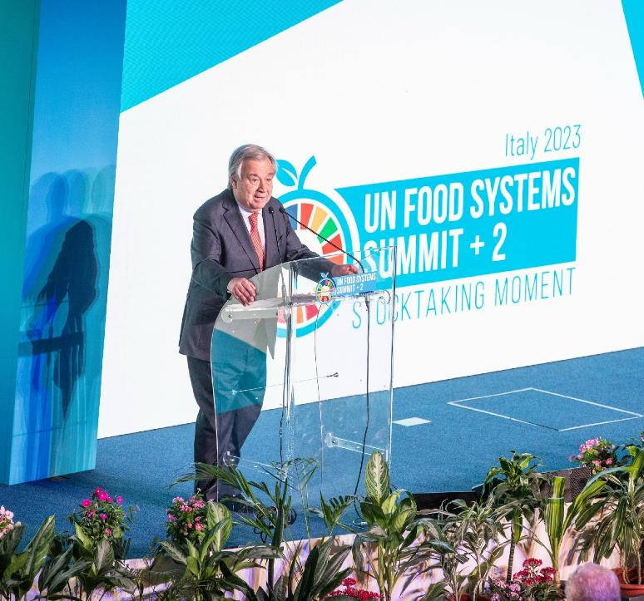
UNFSS Chair summary:
a bi-annual convening of food systems actors
“The Secretary-General will convene a global stock-taking meeting every two years to review progress in implementing the outcomes of this process and its contributions to achievement of the 2030 Agenda.”

Slide 3
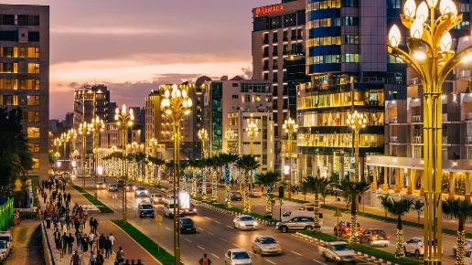
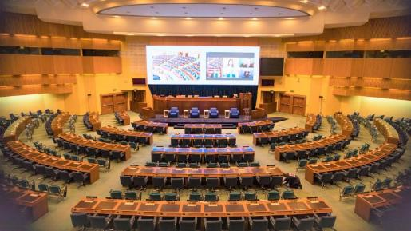
The 2nd United Nations Food Systems Summit Stocktake (UNFSS+4)
Venue: Addis Ababa, Ethiopia, ECA Building
Dates: 27-29 July 2025
27 July: Action Day and field visit(s)
28–29 July: UNFSS+4
Co-Hosts: Ethiopia and Italy
© Eastern_Camera3012
© UN Economic Commission for Africa

Slide 4
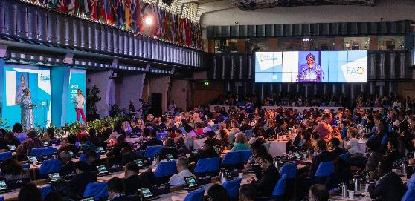
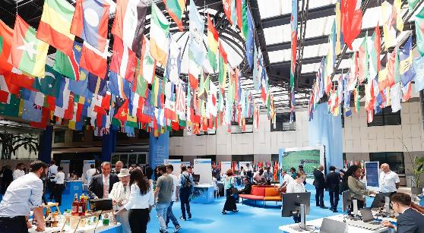
UNFSS+4 Main Objectives
1. Reflecting on Progress
Reflections on what has been accomplished, the lessons learned, and the challenges that remain.
2. Partnering, Tracking Commitments and Accounting for Outcomes
The roles, commitments, and contributions of state and NSAs will be reviewed to identify critical gaps, missing actors, and strengthen engagement.
3. Unlocking Finance and Increasing Investments
Support countries to create environments that address barriers to investment, reinvigorate partnerships, and apply new tools/innovations that lead to action-oriented outcomes.
© FAO/Alessandra Benedetti
© FAO/Alessandra Benedetti

Slide 5
Documentation
Report of the Secretary-General
Update on progress and gaps with the implementation of national food systems transformation and the use of pathways.
Examining the effectiveness of the ecosystem of support and identify levers to accelerate investments in the food systems transformation.
5 chapters foreseen –
Chapter 2 - informed by evidence
Chapter 3 support offered by Coalitions of Action.
Chapter 4 support by UN System through the UN Taskforce.
To date, 75 countries sent in a questionnaire; 55 countries did interviews and 86 delivered verbatim reports at the UNFSS+4 preparatory meetings.
Stakeholder Document
A complementary independent analysis developed by Non-State Actors reflecting their own views on progress and priorities for the way forward to 2030.
Questionnaire distributed to networks from 7 March – 28 April.
Over 350 survey responses received.
Stakeholder type | n
Business and Industry (for-profit organizations) | 42
Farmers/Producers | 57
Children and Youth | 29
Local communities | 28
Science and technology | 26
Academia and universities | 49
Consumer organizations | 3
Indigenous people organizations | 3
Women’s organizations | 11
Philanthropic organizations | 9
Workers and Trade Unions | 1
Other | 84
© FAO/Alessandra Benedetti

Slide 6
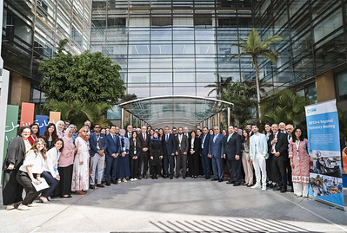
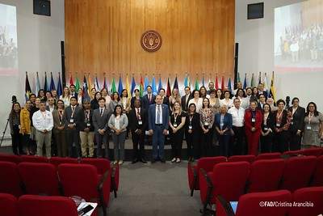
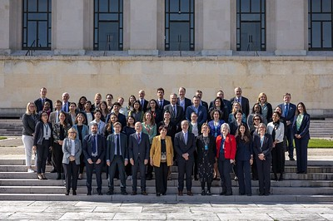
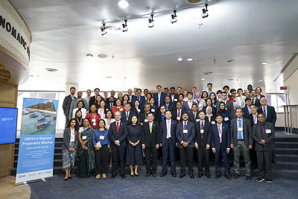
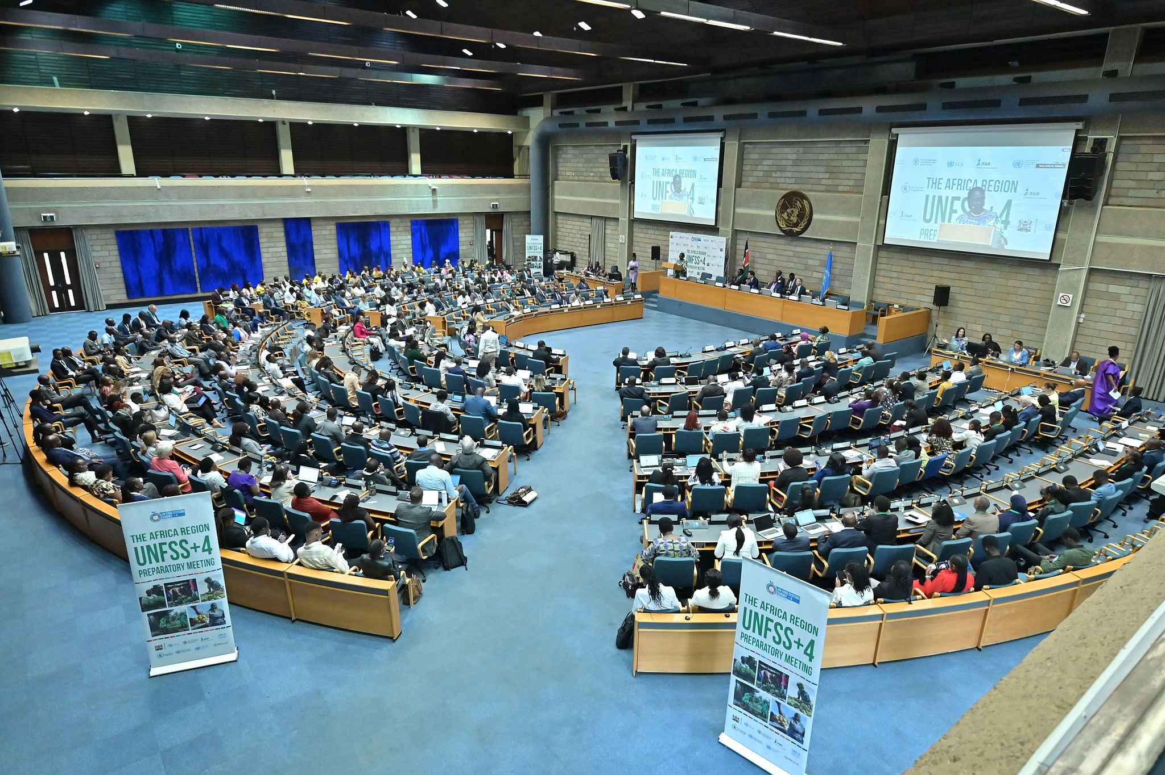
Preparation Process
National level
National Convenors encouraged to steer participatory, multisectoral multistakeholder progress review discussions in country
A targeted questionnaire sent to all countries to structure discussions
Interviews with National Convenors and actors of the EoS
Regional level
Stocktake meeting in each region. See next slide
Global level
Global Youth Conference
Global Touchpoints
Briefings to Permanent Representations (NY, Rome, Geneva, Nairobi)

Slide 7
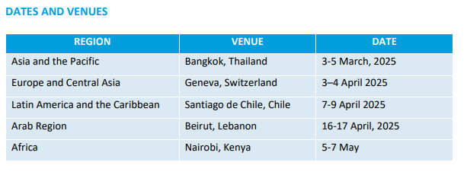
Regional meetings
The regional preparatory meetings convened National Convenors, representatives from relevant regional institutions and other UN Agencies, civil society, academia, private sector, and IFIs, and other organizations to gather inputs contributing to the organization of the UNFSS+4.
Each regional meeting spanned 2-3 days and integrated plenary sessions, interactive discussions, and peer-learning opportunities.
The National Convenors (or their representatives) were invited to participate in one-to-one in-depth interviews with Hub staff to share more details on country-level action.

Slide 8
Engagement with Non-State-Actors
Hub Stakeholder and Networking Advisory Group (SENA)
Additional engagement
Open Survey to all NSAs
Responsible for the Stakeholder’s report
In touch with CFS (CSIPM) which has been offered space to contribute to the process
Continuous engagement for the preparatory events
Coordination with other relevant NSA bodies like the WFF, UN Major Groups
Opportunity for Stakeholder events during the Action Day
Office of UN Special Envoy on the Youth

Slide 9
UNFSS+4 Programming
Action Day – 27 July
Stimulating, with a combination of field visits, a special youth engagement space, thematic sessions jointly organized by coalitions of action, co-hosts and UN entities, side-events, and concluding with a plenary roundtable of action where countries will be invited to reflect on the field visits and contribute their experience from their transformation journey.
Side events - The selection panel will be multistakeholder (the Rome-based agencies, the Hub, and 2 representatives from the Stakeholder Engagement and Networking Advisory (SENA) Group).
Main sessions – 28-29 July
High level opening and closing
High-level panel – Meetings with a full multi-stakeholder orientation, opened by panels with leaders and experts to inform broad discussion.
Ministerial Roundtables - Meetings with an orientation towards Ministerial dialogue, even as they are open to all stakeholders. They could have keynote speakers and/or expert respondents to add value to the discussion.
Investment dialogues – two types :
Discussions that explore issues related to investment approaches that support a solution-focused agenda around central food system topics: access to safe and nutritious food for all; sustainability; equitable livelihoods; and resilience to vulnerabilities, shocks and stresses.
The facilitation of deal-making amongst key stakeholders on prioritized topics in specific countries as well as with SMEs.
Thematic / Constituency-led sessions - sessions to either (1) offer constituencies to have self-organized sessions and (2) address priority topics that may not have sufficient space in the main programme.
© FAO/Alessandra Benedetti

Slide 10
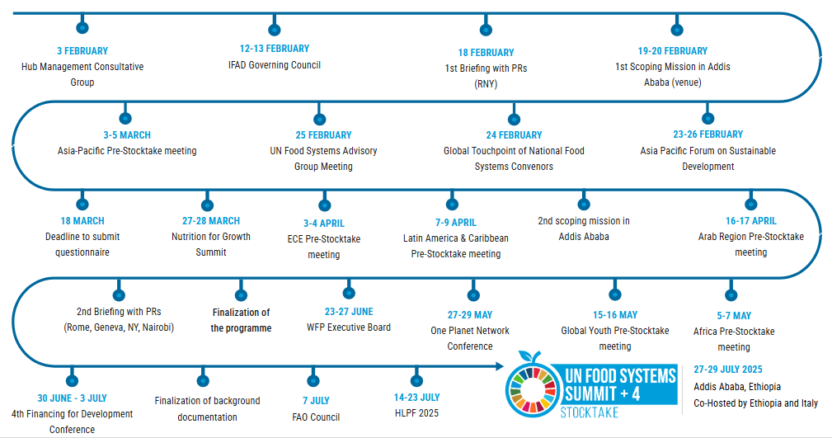
Towards UNFSS+4: Roadmap

Slide 11

After UNFSS+4: Roadmap
3-4 OCTOBER
Stockholm Food Forum
20-24 OCTOBER
Committee on World Food Security (CFS 53)
13-17 OCTOBER
World Food Forum
4-6 NOVEMBER
World Social Summit
10-21 NOVEMBER
COP30
8-12 DECEMBER
UN Environment Assembly

Slide 12




Crucial elements for success
National level preparations with FS National Convenors and country owned process
Get substantive inputs for the UNFSS+4 documentation
Identify national, regional and global milestones and potential contributions.
Increase engagement with Non-State-Actors

Slide 13
Thank you
Contact: fss-hub@fao.org

