Slide 1
Module 1.
Introduction to manure management
Improving manure management

Slide 2
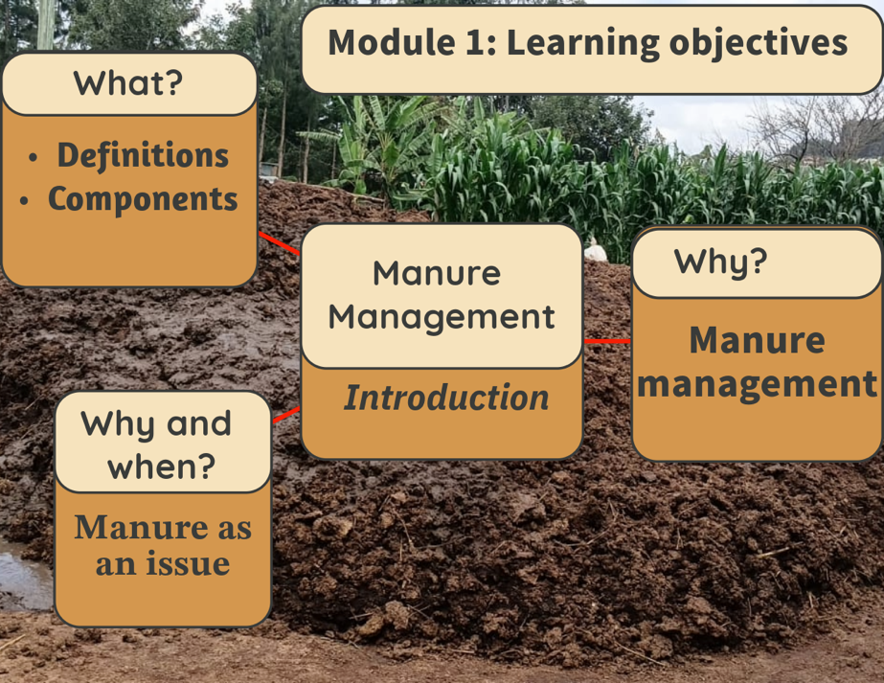
Learning objectives of Module 1
Understand manure basics
Describe why and when
manure is an issue
Understand why manure
management is important:
  Role of manure in nutrient
  cycling and soil fertility
  Environmental effects

Slide 3
Learning objectives
Manure basics:
  To provide trainers with a comprehensive understanding of what manure is, its sources, components and its composition
  To educate trainers on the categorization of manure based on its characteristics and housing systems of animals producing it
Manure management:
    To enable trainers to understand when and why manure management becomes necessary
    To enable trainers to identify poor management practices and their associated environmental effects
    To provide trainers with an in-depth understanding of the benefits of effective manure management practices and the concept of nutrient recycling
    To provide trainers with a comprehensive understanding of manure management along the whole manure chain

Slide 4
Manure basics

Slide 5
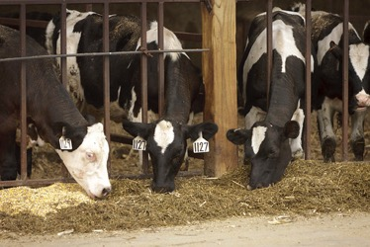
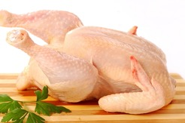
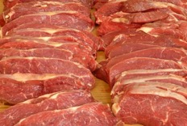
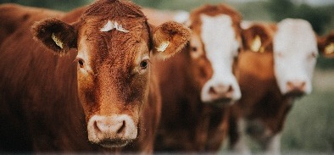

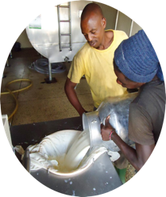
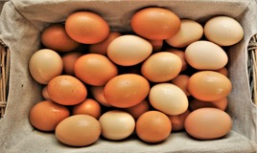



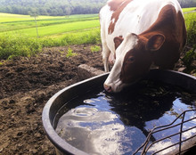
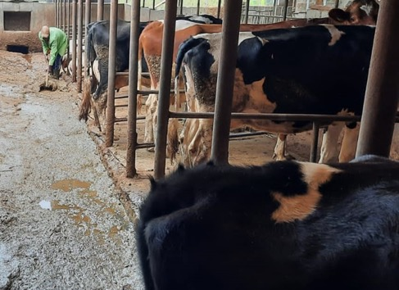
What is manure?
Natural by-product of animal production: excreta of animals, often mixed with bedding materials or spilt feed or diluted with water
Outputs
Inputs
Farm animals
Feeds
Main products
Water
Feed intake
Metabolism
Excretion
By-product: Manure

Slide 6
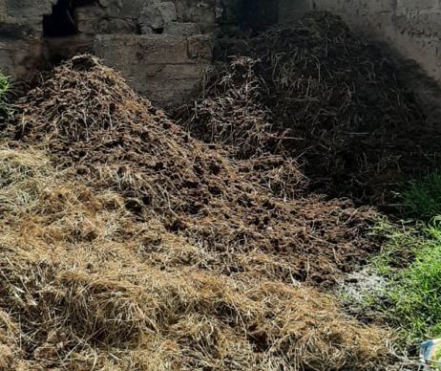
Types of manure: Some definitions
Excreta:
  faeces or dung: undigested feed components (nutrients)
  urine: metabolic waste and excess nutrients
(Cattle, pig) Slurry: mixture of faeces and urine often diluted with water
Farmyard manure (FYM) or manure: excreta (faeces and urine), mixed with
bedding materials and spilled feedstuffs
Bioslurry or digestate or effluent: the effluent from a biodigester
Urine
Dung/
faeces
(Manure) Slurry
Excreta
+
  Spilled feedstuffs
  Bedding materials
=
Farmyard manure
Notes:
Excreta: metabolic waste and excess nutrients are nutrients that are digested but excreted via blood, liver and kidneys. Urea (N) is a major component of excess nutrients and potassium.
Bioslurry is often called digestate or effluent and is in fact the excreta from the biodigester that is excreted through a pipe. In the biodigester itself, sediment is also stored and cannot be removed easily.

Slide 7
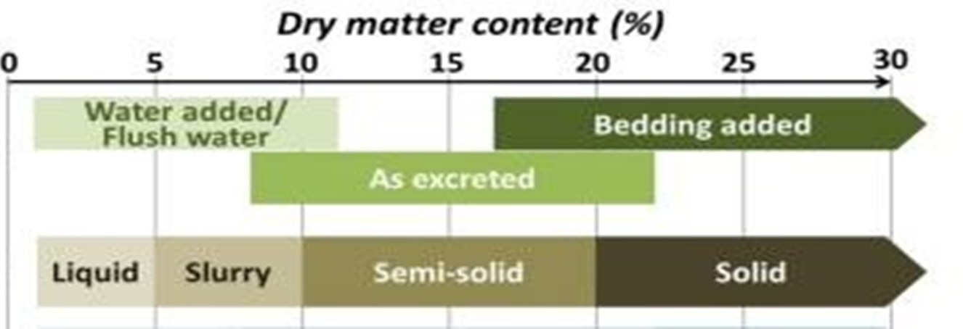
Types of manure (based on dry matter content)
Liquids: mainly urine with little dung and often diluted with water (max 4% dry matter)
Slurry: mixture of faeces, urine (cattle, pigs); often diluted with water
(4% to 10% dry matter)
Semi-solid: often faeces (10% to 20% dry matter)
Solids: mainly dung or mixed with bedding materials,
poultry manure, farmyard manure (> 20% dry matter)
Notes:
It is important to know what type of manure it is and its history as this will very much affect the composition and the fertilization value of the manure.

Slide 8
Types of manure
The type of manure affects:
  Its collection, storage, handling and use
  Potential nutrient losses
  The feasibility of improved manure management practices
Moisture content (dry matter content) of manure: an important property for manure collection, storage, handling, treatment and utilization/application
Moisture content (dry matter content) of manure is mainly determined by:
  The content of dung (solid excreta)
  The use of bedding material in barn
  The addition/dilution with water (for cleaning)

Slide 9
Components of (farmyard) manure
Undigested feed components in dung:
Consists of a wide range of organic compounds
Source of nutrients like nitrogen, phosphorus and potassium
Can also contain weed seeds
Manure
Dung
Spilled feed wastes
Urine
Bedding materials
Straw, sawdust, wood shavings, etc. of bedding materials:
Organic matter
Increases carbon
content of manure
Feed spill or feed refusals:
Source of organic matter
Source of nutrients: nitrogen phosphorus and potassium, etc.
Metabolic waste and surplus nutrients in urine:
Source of nutrients: nitrogen (urea), phosphorus (pigs) and potassium, etc.

Slide 10
Type of manure and confinement/housing
Housing/confinement system
Free range (grazing system) | Dry faeces (collected from the pasture)
Free range + night enclosure (night boma, kraal) | Dry faeces (from pasture or night enclosure)
Animal tied (tethered), faeces collection | Wet faeces (solids)
Zero grazing unit/shed, faeces collection | Wet faeces (solids)
Zero grazing unit, concrete floor: frequent scraping/flushing with water | Liquid slurry (urine and faeces mixed with water)
Zero grazing unit, with bedding on floor | Solid farmyard manure (mainly faeces bedding material; urine partly absorbed by bedding material)
Notes:
Type and quality of manure depends very much on the confinement or housing system. In a free range or grazing system, excreta are deposited on the land directly, but in some cases the faeces droppings can be collected (in Ethiopia and India the faeces is collected, dried and used as fuel). In semi-zero grazing systems, however, cattle are confined at night in an enclosure. In zero-grazing systems cattle are confined all the time, and the way the animal is kept and the type of housing determines the quantity and quality of the manure that can be collected.

Slide 11
Type of manure in pasture-based dairy production systems
Manure management in pasture-based systems (free range, grazing with enclosure at night [night boma, kraal]):
Manure collected from extensive pasture-based system is mainly the solids; the (urine will have drained into the soil):
  Collection of (dried) dung from field is an option
  Dried solids from night enclosure can be collected and used
  30% to 40% of the solids excreted could be collected and used
Notes:
The amount and quality of dung and urine produced by animals is very variable due to differences in feed quality and water intake.
Nutrient losses due to leaching and run-off can be high if the (night) enclosures are not roofed.

Slide 12
Type of manure in intensive dairy production systems with cattle confined
Type of confinement determines the type of manure and nutrient losses:
Deep litter system with cattle free to walk and rest in an enclosure:
  Use of bedding material (mixed with the excreta)
  Nutrient losses can be high
Sheds/zero-grazing units with cubicles for cows to rest; quality manure depends on:
  Type of shed (roofing)
  Quality of walking area (concrete floor, soil; maintenance of the floor)
  Collection system: as slurry or separate collection
Notes:
In deep litter systems, the manure is easy to handle; nutrient losses depend on the type of bedding. If bedding materials absorb the urine, N losses might be reduced.
In sheds or zero-grazing units, manure can be collected as slurry, or collected separately as solids and liquids. The type of floor walking area and roofing of the shed or walking area determines losses.

Slide 13
Manure: Why and when is management needed?

Slide 14
When is manure management required?
Manure management is needed when animals are confined or kept in one place during part of the day
Accumulation of manure in small area can result in:
  Pollution of environment: water and air pollution
  Decrease in soil fertility when nutrients are lost and manure is not recycled
  A nuisance to the neighbourhood (smell, flies)
  Risk of disease transmission (animal, human diseases)
Notes:
Manure requires management in:
Zero grazing or cut and carry systems
Animals tied in one place
Animals kept at night in an enclosure
Then there is a risk of accumulation of large amounts of excreta in a small area.
Pollution of the environment can be caused by run-off of manure to streams and rivers after heavy rainfall, drainage/leaching of nutrients to groundwater, volatilization of ammonia to the air.
Diseases that can be transmitted by means of manure are, among others, foot and mouth, E coli infections.

Slide 15
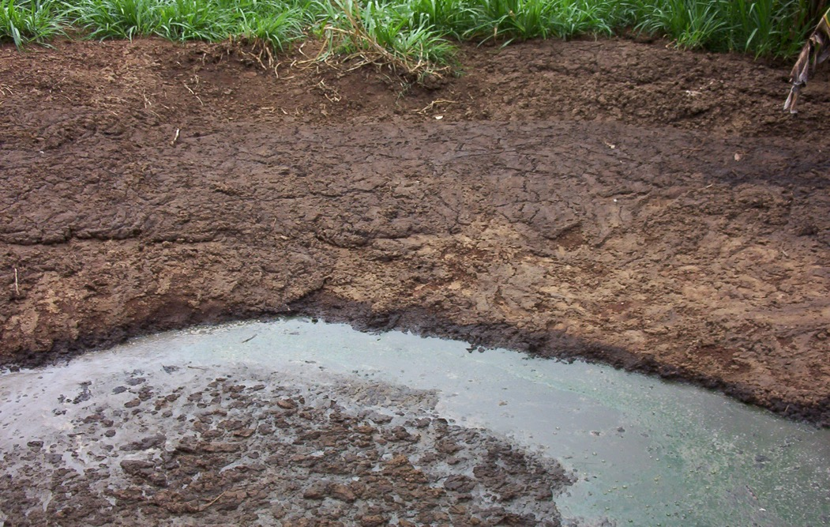
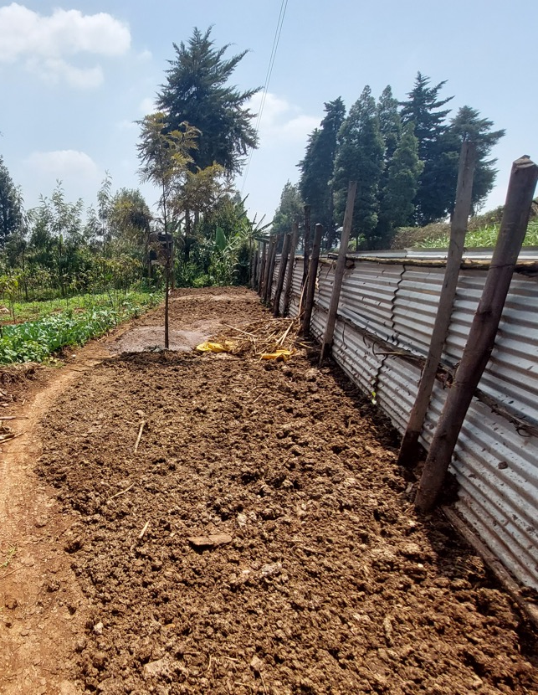
Poor manure management: nutrient loss and negative effects on environment
Notes:
Nitric acid and methane are greenhouse gas contributors.

Slide 16
Environmental effects of nutrient losses of manure
Volatilization to air: ammonia N, nitric acid N, methane
Leaching to groundwater due to large manure loads or over-fertilization:
  Nitrate (N), P when soils are P saturated
  K and other minerals
Leaching/run-off to public areas/surface water:
  N, P, K, other minerals and organic matter during heavy rainfall
  or discharge to public areas
Notes:
Losses:
N: ammonia loss during collection, storage, application
N: nitric acid during anaerobic conditions in storage
C: carbon: methane under anaerobic conditions in storage.
Nitric acid and methane are greenhouse gasses contributing to climate change. Ammonia is not a greenhouse gas but contributes to a higher concentration of nitrogen in the atmosphere and rain.
Pollution of groundwater with nitrate could lead to higher concentrations of nitrate in drinking water if groundwater is used and may affect human health. Excessive P due to overfertilization can lead to saturation of P in soils. Most tropical soils are P-fixing soils so the saturation of P will only occur with very large loads. Overfertilization is a waste of nutrients.
Run-off of manure can easily lead to eutrophication of water in lakes of reservoirs and cause algae growth, killing water organisms, fish etc while the water is not suitable anymore for human use.

Slide 17
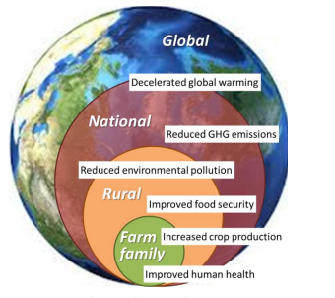
Benefits of good manure management
Recycling and preservation of nutrients to improve soil fertility
Reduction of need for synthetic fertilizer
Protection of human/animal health/safety
Reduction of environmental effects on:
  air (ammonia, greenhouse gasses [GHG])
  water (ground and surface water)
Contribution to economic viability and resilience:
Manure fertile soil s higher production higher income farmer

Slide 18
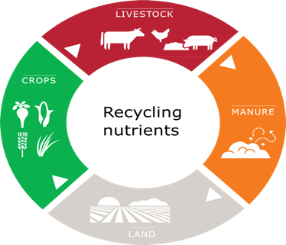
Nutrient cycle in crop–livestock system
Notes:
The picture of the nutrient cycle shows that the recycling of manure is a very important component to maintain soil fertility. It shows where nutrients are removed (produce and sales) and where nutrients can be lost. Losses occur especially with the manure component and soil (manure application and overfertilization).
N fixation by bacteria in combination with legumes can add nitrogen to the plants but also to the soils.

Slide 19
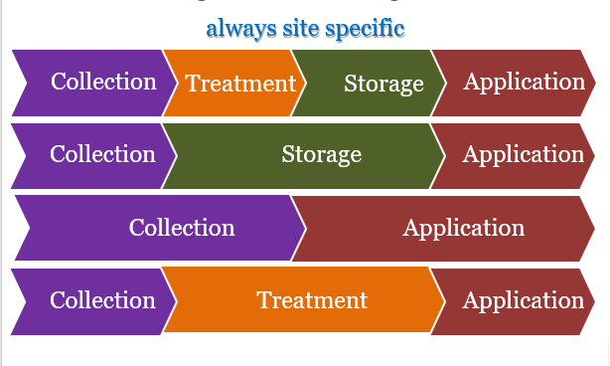
Good manure management
Good manure management is management along the manure chain: from collection to application
Notes:
Management will be always be site-specific and depending on the type of confinement, etc:
1. Example of management of a situation with Collection, Treatment, Storage and Application: Manure put into biodigester: collection and treatment by biodigester, storage of bioslurry and thereafter application on land/crops
2. Example of collection, storage and application: mix of urine and faeces from a zero-grazing unit: collection and storage followed by direct application on land/crop
3. Example of collection and application: mix of urine and faeces collected and directly applied by trenches/furrows to crops/land
4. Example of collection, treatment and application: mix of faeces and urine or only faeces collected and composted (treatment) or dried and thereafter applied on land/ crops

Slide 20
Manure management (1)
Points of attention:
Collection:
  Type of confinement system: open air, shed with cubicles, deep litter?
  Separate collection of excreta or mixed (slurry)?
  Floor in shed: concrete or earthen floor (collection of urine)?
Storage:
  Heap/pile or pit?
  Open or covered/closed storage?
  Pit storage: concrete walls or earthen pit?

Slide 21
Manure management (2)
Points of attention:
Treatment:
  Excreta used for biogas production?
  Excreta mixed with other organic materials: bedding, feed residues?
  Excreta to be dried?
  Excreta composted (mixed with other materials)?
Application/use:
  Recycling to the land/crops?
  Method of application to the land: via trenches, surface application or incorporation of manure into the soil?
  Sale of manure/compost ?

Slide 22
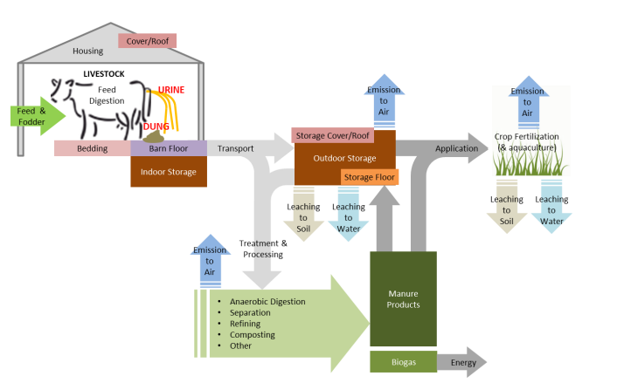
Focal points of manure management
1
4
3
2
Notes:
Housing
Roofing?
Floor type?
Roofing and floor type influence collection (dilution with rainwater, drainage of urine) and handling practices (more or less solid manure)
Treatment option/method
Indicative of the nutrients and extent of nutrient preservation/losses and the possibilities for handling. Biodigestion produces liquid slurry; (mechanical) separation produces liquids and solids (more faeces part); refining is a technological process of extracting nutrients from manure for other purposes; composting means that other materials are added and losses can be variable.
3. Storage
Use of cover?
Floor?
Use of covers to protect from rain and sunshine will reduce nutrient losses, and sealed storages will do so as well.
4. Application method
Application method on land should be aimed at reducing nutrient losses, especially volatilization of ammonia, and overfertilization should be avoided to prevent leaching of nutrients.

Slide 23
Summary
Manure can have many different characteristics and composition.
Manure management is much needed when animals are confined.
Good manure management requires management along the whole manure chain of collection, storage, treatment and application.
Good manure management will focus on reducing nutrient losses, which will lead to less pollution of the environment.
Good manure management will lead to fertile soils, better crop production, better income of farmers, a better environment and healthier people.

