Slide 1

Improving manure management
Module 2. Manure composition and nutrient losses

Slide 2
Learning objectives of Module 2
Understand the factors affecting manure quantity and quality:
Impact of animal species, diet and manure management practices on manure characteristics
Understand the interplay of different factors and pathways of manure nutrient losses:
Main pathways of nutrient losses: Leaching, run-off, volatilization and drainage
Strategies to prevent nutrient losses

Slide 3
Manure: Quantity and quality

Slide 4
Factors affecting manure quantity and quality
Major factors that determine manure quantity and composition:
Manure characteristics as excreted depend mainly on:
animal species, bodyweight and age
feeding regime
The quantity and quality of the manure as stored depend mainly on:
production system: grazing, confined
animal housing
manure management practices: collection, storage and treatment
e.g. addition of water for flushing and/or organic materials, treatment such as composting

Slide 5
Animal species and composition of excreta
Digestive system determines type and composition of excreta:
ruminants and pigs: dung and urine; poultry (birds): only one type of excreta
cattle digest fibrous feed: excreta contain more organic matter
organic matter of cattle dung: slower breakdown than that of pigs
urine from cattle contains mainly N (urea) and K; urine from pigs (monogastric animals) contains N (urea), P and K; poultry excreta contains N (uric acid), P and K.
Notes:
The dung of ruminants contains more organic matter which breaks down slower than the dung of monogastric animals. Ruminants consume fibrous feeds which contain low or non-digestible organic materials. The diet of monogastric animals is more digestible; while the manure contains organic matter, it is broken down more easily in the soil by micro-organisms.

Slide 6
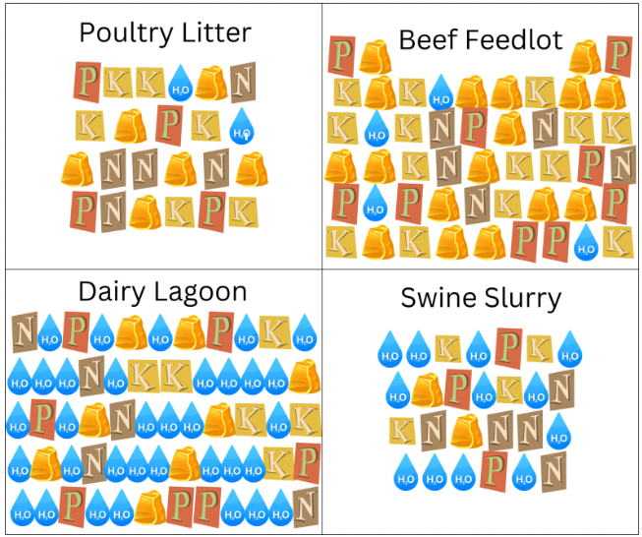
Animal species and composition of excreta

Slide 7
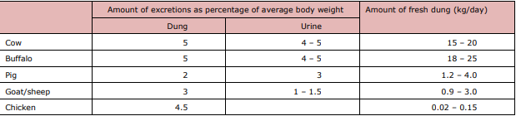
Animal species and amount of excreta
Source: E. Teenstra et al. 2015. Manure Management in the (Sub-)Tropics; Training Manual for Extension Workers
Cows weighing about 250 kg to 400 kg.

Slide 8
Composition of cattle excreta
Macro nutrients
Primary nutrients:
nitrogen (N) in the dung and urine
phosphorus (P) in the dung
potassium (K): mainly in the urine
Secondary nutrients mainly in the dung: magnesium (Mg), calcium (Ca), sulfur (S)
Micro nutrients or trace elements in urine and dung:
Na, Cl, Cu, Zn, B, Mn, Fe, Cr, Mo, Co, Se
Organic matter: many nutrients are bound in organic form

Slide 9
Example of composition of dairy cattle slurry
Nutrient in cattle slurry | Content of nutrient (%) On fresh weight basis
Dry matter | 12.0
Organic matter | 7.7
Nitrogen (N) total | 0.21
Phosphorus (P) | 0.06
Potassium (K) | 0.50
Calcium (Ca) | 0.21
Magnesium (Mg) | 0.07
* Slurry collected in a zero-grazing unit with concrete floor and stored for short time in closed concrete pit
* Dairy cows fed with Napier grass and concentrates (1988-1989); Source: Snijders et al., 1992

Slide 10
Amount and composition of cattle excreta
Feeding regime affects amount and composition of cattle excreta:
Amount and composition of urine depend (among others) on:
intake of water and feed (N and K among others), temperature (evaporation)
Nitrogen levels depend on intake of protein:
high levels in ration relatively high levels in urine and dung
Phosphorus in dung and potassium in urine vary with levels in the feeds
Quality of organic matter in dung (carbon/nitrogen [C/N] ratio) varies with the digestibility of the ration/fodder
Notes:
The amount and composition of the urine is very much affected by water intake. If water intake is restricted as is often the case or ambient temperatures are high the amount of urine produced is less, and concentration of nutrients is higher. Also, feeds with a high concentration of potassium will lead to a higher urine production, as this nutrient is hardly used by the animal.
Excess nitrogen is mainly excreted in the urine.
The quality of the organic matter affects the speed at which it will be broken down in the soil. This is often expressed in the form of the carbon/nitrogen ratio. If this ratio is high, then the breakdown will be very slow. Dung with little N due to feeding of low-quality forage will have organic matter with a high carbon and low N content.

Slide 11
Nitrogen in cattle excreta (1)
Type of nitrogen in faeces and urine is different:
N in urine: mainly present as urea (N-mineral)
N in faeces: mainly present in organic compounds (N-organic)
Total excretion of nitrogen (but also other nutrients like phosphorus) increases with feeding/production level
Excretion of nitrogen in urine and dung varies with protein intake:
the higher the protein intake, the higher the excretion

Slide 12
Nitrogen in cattle excreta (2)
Faeces: N bound to complex organic compounds (N-organic):
Nitrogen in organic form (N-org): breakdown by micro-organisms to mineral N (nitrate) before available for plant growth
N-organic differs in quality depending on quality of feed:
amount and quality (digestibility) of the fibres in the feed
Breakdown of N-organic depends on quality N-org and climatic conditions (temperate, moisture):
In temperate areas: on average 35% of N-org becomes available for crops in first year after application

Slide 13
Nitrogen in cattle excreta (3)
Urine: N in the form of urea (N-mineral):
The amount of N in urine depends on feeding/production level
Urea from urine in contact with dung (in cattle slurry) is easily converted into ammonia by bacteria: high temperature increases the conversion
Ammonium is susceptible to volatilization to the air when in
contact with air: loss of N mineral can be very large
Ammonium in contact with soil is converted by bacteria into nitrate

Slide 14
Effect of feeding/production level on nitrogen excretion by a dairy cow (based on Snijders et al., 1992)
 | Dairy cow Body weight: 350 kg Milk: 3 kg per day | Dairy cow Body weight: 450 kg Milk: 8 kg/day | Dairy cow Body weight: 550 kg Milk: 20 kg/day
Slurry production/cow/day | 35 kg | 45 | 61
Total N excretion/cow/day | 96 gr/day (=100 %) | 141 gr/day (=100) | 233 gr/day (=100%)
N excretion in urine/cow/day | 43 gr/day (=45%) | 64 gr/day (= 45%) | 116 g/day (=50%)
Total N excretion/cow/year | 35 kg | 51 kg | 85 kg
C/N ratio of dung (estimate) | 41 | 37 | 26

Slide 15
Why so much emphasis on nitrogen in manure?
Nitrogen is a key element for plant growth: enhancing production and product quality
The effect of nitrogen is the most visible to the farmer: green colour, growth of crop
Nitrogen in manure can easily be lost (leaching, volatilization, run-off)
Nitrogen can cause pollution of ground and surface water when stocked at one place or through overfertilization of land
Nitrogen is a key element of most synthetic fertilizers
However, manure contains more than only nitrogen!

Slide 16
Benefits of other nutrients in cattle manure
Phosphorus/phosphate (P/P2O5)
Most African soils are deficient in phosphate
Lack of phosphate affects root growth of crops
Phosphate in manure is readily available for crop growth
On acid soils: phosphate from manure is more available for crops than phosphate from synthetic fertilizer
Potassium (K/K20):
K is a key element for growth of crops like forage, bananas, coffee
K is often deficient in sandy soils; often sufficiently available on clay soils
Calcium (Ca):
Calcium has a neutralising effect on acid soils

Slide 17
Benefits of organic matter in cattle manure
Organic matter of manure improves soil quality by:
Providing nutrients for plant growth: slow release of macro and micro
nutrients
Improving soil fertility: builds up the nutrient base of the soil
Improving soil life: provides food for micro-organisms
Improving the water-holding capacity of the soil
Improving the soil structure
Reducing soil acidity

Slide 18
Nutrient losses and prevention strategies

Slide 19
Run-off and drainage of manure nutrients into soil
Run-off and/or drainage of manure nutrients will occur if:
Manure is discharged directly to public areas, water streams (losses can be extensive)
Poor storage of manure heaps or piles: not protected during heavy rainfall or put on sloping land
Manure flows in trenches to the land combined with heavy rainfall
Applying manure in (too) large amounts superficially on land combined with heavy rainfall

Slide 20
Potential nutrient losses from manure
Run-off/drainage:
N, P, K, other minerals and organic matter
Volatilization:
N: ammonia and nitric acid
C: methane
Leaching/drainage to ground water:
N: nitrate at spots with large manure loads or overfertilization of land
P: excessive manure loads can lead to phosphate saturation of soils
K and other water-soluble minerals: excessive manure loads, over
fertilization of land

Slide 21
Strategies to reduce run-off/drainage losses
Use proper (closed) collection and storage system.
Use a cover to protect manure heaps/piles from rain.
Avoid overfertilization of land.

Slide 22
Volatilization of manure nutrients and prevention (1)
Volatilization of nitrogen (N) in the form of ammonia
Ammonia is converted from urea and uric acid by bacteria when urine comes in contact with dung or soil
Volatilization of ammonia occurs in animal housing, manure storage, during application of manure onto land
Losses of N can be extensive (30–70% of total nitrogen) in cattle slurry

Slide 23
Volatilization of manure nutrients and prevention (2)
Volatilization of nitrogen in the form of nitrous oxide (N₂O) and methane (CH₃)
Nitrous oxide and methane: conversion of mineral N under anaerobic conditions
Both gasses are volatile and contribute to GHG emissions (climate change)
Nitrous oxide is a product of the denitrification process of nitrate
Nitrous oxide and methane can volatilize from manure storage (anaerobic pockets) and after application on land (wet conditions)

Slide 24
Strategies to reduce volatilization losses by ammonia N
Separate collection and storage of urine and faeces in the barn
Concrete the floors of walking areas in zero-grazing units with cubicles
Roof the walking areas of a zero-grazing unit
Frequently remove of dung and urine (slurry) into a closed storage pit
Mix cattle slurry with soil at time of application
Apply slurry on land/crops when rain is expected

Slide 25
Strategies to reduce volatilization losses by N₂O and methane
Prevent overly long and anaerobic storage of manure
Avoid application on overly wet land

Slide 26
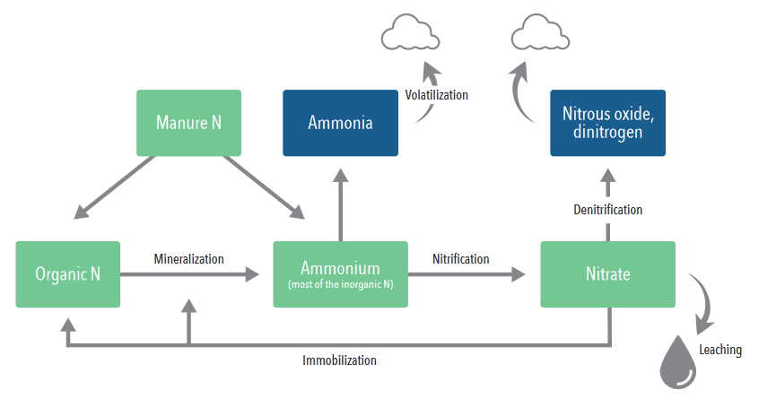
Overview of nitrogen losses from manure
If not incorporated
Nitrate is water soluble; it can move downwards through the soil profile to groundwater
Run-off

Slide 27
Leaching of manure nutrients and prevention
Leaching of manure nutrients:
Water-soluble nutrients like N and K can leach to deeper soil layers and/or groundwater
Leaching can happen on spots with excessive manure loads (manure storage on open land) or overfertilization of land
Leaching of manure nutrients can lead to contamination of drinking water (nitrate, phosphates) taken from wells
Leaching of P to groundwater can happen on P-saturated soils
Strategies to reduce leaching losses:
Use of good (closed) collection and storage system
Prevent overfertilization: application of manure on land according to crop needs

Slide 28
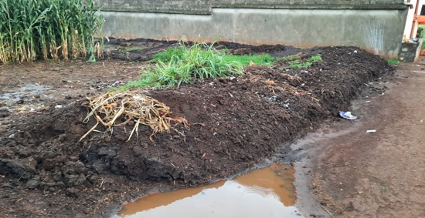
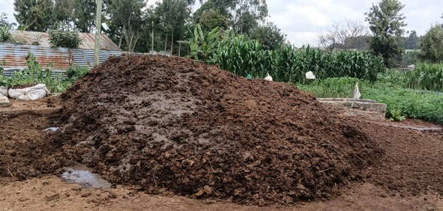
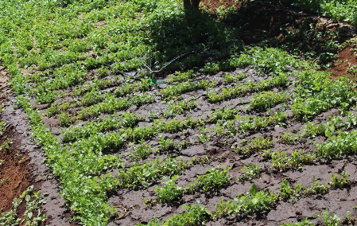


Effect of poor manure management on water quality
Improper manure piling
Improper manure storage
Improper application
Run-off
Run-off
Run-off
P
OM
N
Leaching
Surface water
Leaching
Nitrate
Nitrate
N
Underground water
N

Slide 29
Summary
The quantity and value of cattle manure for crop production will depend on:
the composition of the excreta (feeding/production level)
the production and housing system (confinement, collection system, use of bedding materials)
the management of the manure from collection until application
nutrient losses due to manure management (collection, storage,
treatment and application)
Major nutrient losses can occur in the form of volatilization, run-off and
drainage and leaching but can be reduced by better management practices.

