Slide 1
Module 4.
Manure composting
Improving manure management

Slide 2
Learning objectives of Module 4
Describe basic composting principles:
  Methods
  Ideal requirements and conditions
  Common troubleshooting issues and solutions
  Composting in practice

Slide 3
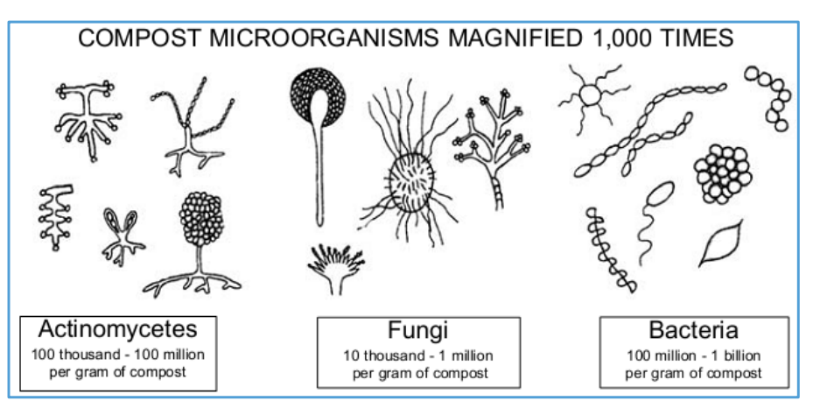
What is composting?
Composting is a natural process where organic materials decompose through the actions of bacteria and other micro-organisms
The result is a stable product (compost) that can be used to improve soil fertility and to fertilize crops

Slide 4
Methods of composting

Slide 5
Methods of composting (1): Aerobic composting
  Most common method of composting
  Organic materials are converted by aerobic micro-organisms
  Process needs oxygen (regular turning, ventilation)
  Loss of moisture, carbon (carbon dioxide) and nitrogen (ammonia)
  Critical success factors: oxygen supply, moisture content and C/N ratio of raw materials

Slide 6
Methods of composting (2): Anaerobic composting
  Process without oxygen: anaerobic conditions
  Organic material is converted by anaerobic micro-organisms
  Emissions of methane and nitrous oxide (GHGs) during the process
  Slow process
  Process can also occur under semi-anaerobic conditions: e.g. less frequent turning of compost pile

Slide 7
Methods of composting (3): Vermicomposting
  Aerobic composting with the assistance of earthworms
  Compost consists mainly of the excreta of the worms
  Compost is very fine

Slide 8
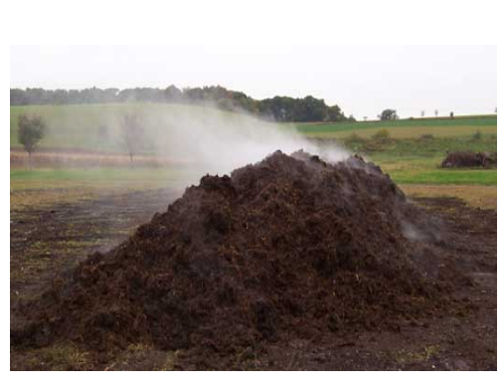
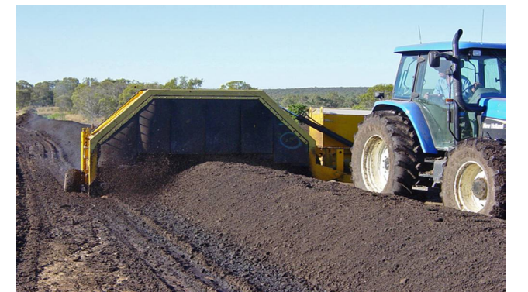
Aerobic composting

Slide 9
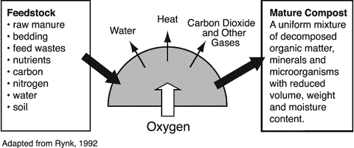
Process of aerobic composting

Slide 10
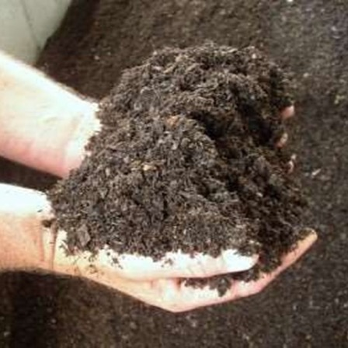
Benefits of aerobic composting of manure
More vegetative (dry) material can be added: more nutrients in compost
Pathogens and most weed seeds are killed: final compost is a safe and hygienic product
The volume of most materials is reduced (most water is evaporated): better handling and easier application of final product
Final compost is stable (nutrients) and does not smell bad
Final compost is easy to store in bags and to transport
Process is relatively fast (2 months or less)

Slide 11
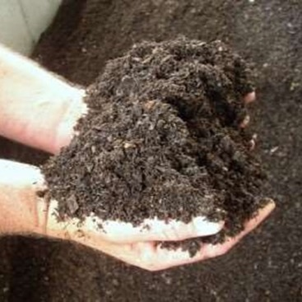
Limitations of aerobic composting of manure
The process of aerobic composting is rather labour intensive: people are needed to monitor (temperature), turn and aerate the compost pile regularly
Considerable losses of N and organic matter (C) can occur during the process
Critical factors like moisture content of the pile, C/N ratio and aeration (turning process) slow down the process if not optimal

Slide 12
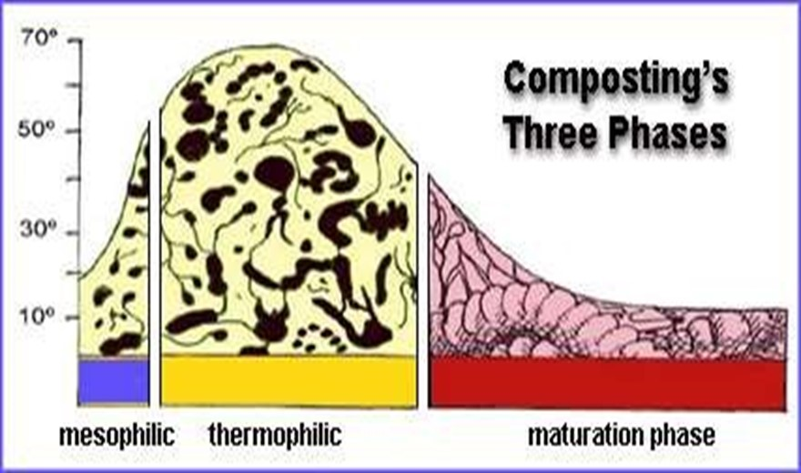
Process of aerobic composting
Composting phases:
Mesophilic
Thermophilic
Maturation
Duration of process:
depends on critical
parameters:
normally 1–2 months

Slide 13
Temperature during composting
Temperature is a good indicator of composting progress: it varies according to the phase of composting
Starts at ambient temperature
Temperate rises during mesophilic phase to 65–70ºC (thermophilic phase): killing most of pathogens and weed seeds
Temperature drops again to ambient temperature at maturation phase
Temperature should not drop too fast to achieve a higher decomposition rate and hygienization of material (killing of pathogens and weed seeds)

Slide 14
Ideal requirements and conditions

Slide 15
Critical factors aerobic composting process (1)
1. Oxygen (ideal content 5–15% in the heap or pile):
Needed for growth of aerobic micro-organisms
Sufficient oxygen supply achieved by:
  controlling the particle size, moisture content, pile size and ventilation
  frequent turning and mixing of the pile to aerate the material
Oxygen | Problems | Indication | Solutions
< 5% (low aeration) | Low water evaporation Anaerobic environment | Odours and acidity | Regular aeration, turning Ventilation
> 15% (excessive aeration) | Low temperature (drop) High loss of moisture Decomposition process stops | Low temperature | Adding water or fresh materials Chopping of the materials

Slide 16
Critical factors aerobic composting process (2)
2. Moisture content (ideal 40–65% in the pile)
Moisture supports metabolic activity of the micro-organisms
If the pile is too dry (moisture content <40%):
  composting slows down or temperature becomes very high (risk of fire) → add water
If the pile is too wet (moisture content >65%):
  anaerobic spots (emission of methane and possibly nitric acid)
  temperature remains low, composting process slows down → add dry vegetative materials
Moisture content of good finished compost product: about 30%

Slide 17
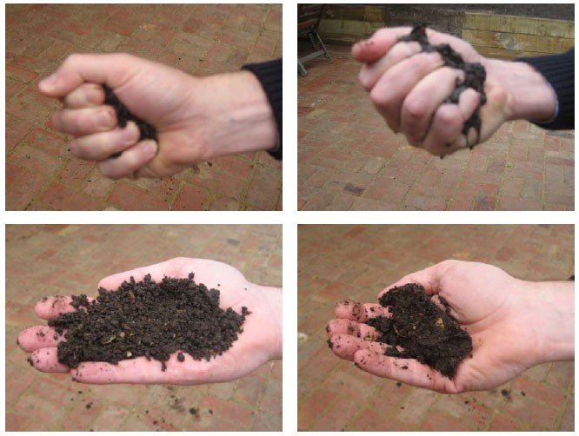
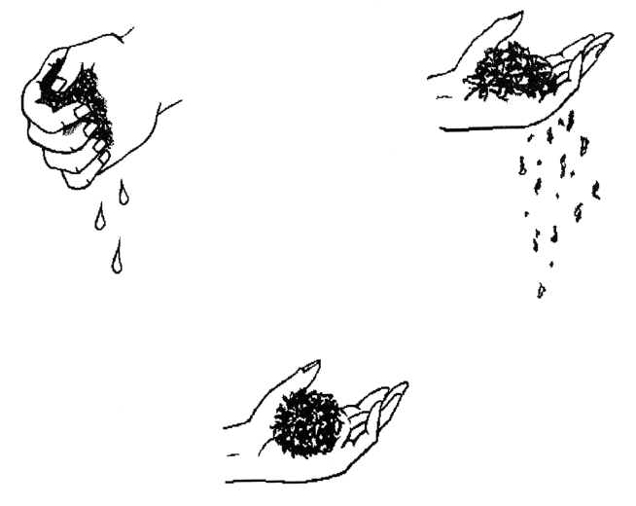
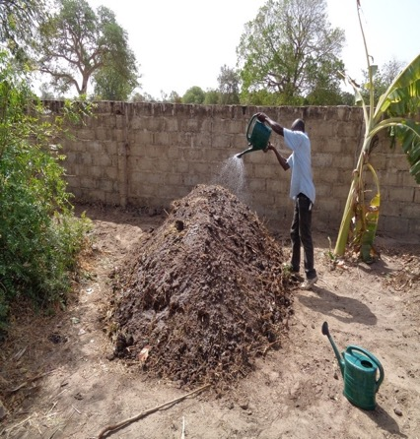
Moisture indication: squeeze test
Too dry
Too wet
OK

Slide 18
Critical factors aerobic composting process (3)
3. Carbon(C)/Nitrogen (N) ratio
The C: N ratio in the pile depends on the type of materials used
Optimum C/N ratio at the start is 25:1 to 35:1 and reduces during the composting process
If C/N ratio is higher than 35 (low N in pile) at the start, composting process will be slow due to lack of nitrogen (N)
If C/N ratio is lower than 25, (high N in pile),composting process could be fast, losses of N (ammonia) can be high
Final product C/N quotient will have a C/N ratio ranging from 10:1 to 15:1

Slide 19
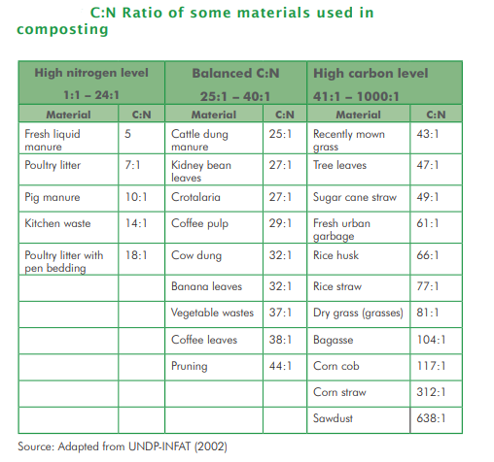
C/N ratio of different materials for composting

Slide 20
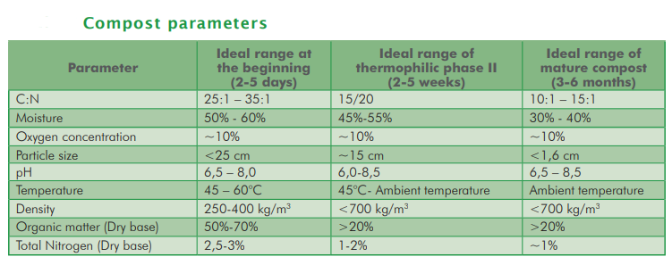
Parameters different phases of aerobic composting

Slide 21
Anaerobic composting
Process:
Occurs in absence or limited supply of oxygen
Anaerobic micro-organisms dominate
Little work involved (no turning required)
Loss of nutrients relatively low
Limitations:
Emissions of methane and nitrous oxide (strong GHGs), organic acids, etc.
Production of organic acids: some with strong odours (butyric acid) and some are phytotoxic
It is a low-temperature process, which leaves weed seeds and pathogens intact
The process usually takes a long time (up to 8 months)

Slide 22
Composting in practice

Slide 23
Composting methods (1)
1. Heap or pile composting: aerobic composting process
  Suitable for areas with higher rainfall
  Ventilation (oxygen supply) by regular turning of the pile: inside out and outside in
  Temperature is a good indicator for progress of the process
  Permeable cover is needed to protect from rain (control of moisture content)

Slide 24
Types of inputs used for composting (1)
Organic materials commonly used for compost making are:
Manure, bioslurry (effluent)
Young twigs (branches of trees), cut into small pieces
High carbon materials: dry vegetative materials such as crop residues (stovers), seed husks, stems of Napier grass, dead leaves, dry grass, feed residues
High nitrogen-rich material – includes green vegetative materials: green weeds, young grass, legumes, hedge cuttings (e.g. tithonia [Tithonia diversifolia]), kitchen waste (food leftovers), fruit and vegetable peelings, etc.

Slide 25
Types of inputs used for composting (2)
Other materials that can be added:
Top soil or soil from forest: adds useful micro-organisms
Ash: provides minerals such as potash, phosphorous, calcium and magnesium. It also reduces the pH.
N.B.: Effect of commercial additives/starters (micro-organisms) is doubtful

Slide 26
Tasks to be performed during composting
Selection and levelling of the area for the compost piles:
  At a safe distance from water sources (over 50 metres) to avoid contamination
  Protected against strong winds
  With a slight gradient (to prevent run-off and erosion)
Collection, chopping and piling of (dry) vegetative materials: small pieces
Regular turning of the pile (to start after one week: inside out and outside in)
Monitoring of composting process (temperature, moisture content)

Slide 27
Heap or pile composting: points of attention
  C/N quotient of materials used:
  Pile at the start C/N quotient between 25:1 and 35:1)
    Cattle slurry or dung: cattle slurry: lower C/N ratio than (dried) cattle dung
    Dry dead vegetative materials and crop: high C/N ratio
    Legumes, young grass, tree leaves: low C/N ratio
  Moisture content of the pile: not less than 55% at the start
  Aeration of the heap: vegetative materials to be chopped but not too fine

Slide 28
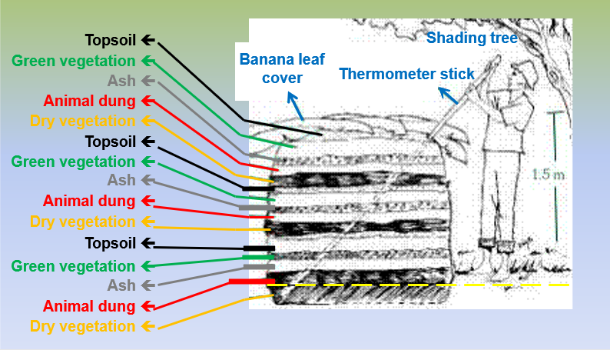
Heap or pile method: preparing the pile

Slide 29
Composting methods (2)
Pit method: mainly semi-anaerobic composting process
  Very suitable for composting of bioslurry (bioslurry flows into the pit)
  Layers of manure and other (organic) materials put into a pit
  Not suitable for wet areas as the compost may become waterlogged
  Turning/ventilation of the pile is more difficult and results in longer process time
  Emissions of methane and nitrous oxide (GHG) can be high

Slide 30
Bioslurry pit compost making
Dig at least 3 pits (depth about 1 m; length and width depend on amount of bioslurry)
Prepare the pits at a location where bioslurry can flow directly into pit 1
Collect small amount of composting material every day (bio slurry to flow into pit 1 and dry materials added regularly (thick layer at the bottom of the pit )
Once pit 1 is full: cover and let it stay for one month to decompose; pit 2 to be filled in the meantime
Empty pit 1 at the end of the second month and put in pit 3 to decompose for another month; this process should be repeated in pit 4 if compost is not ready; pit 1 can be filled again, etc.

Slide 31
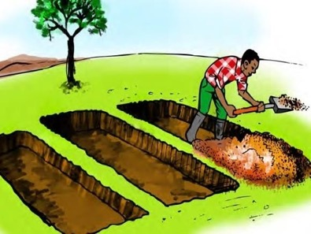
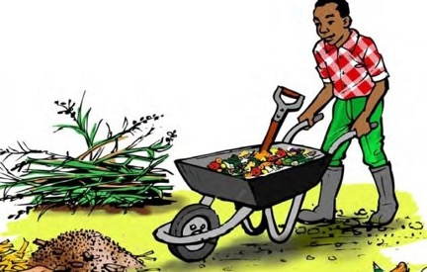
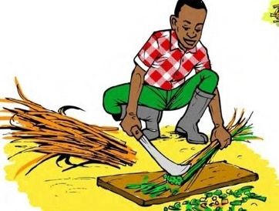
Pit method (sandwich or lasagna method)
1
2
1.2 m (4 feet) wide
and 0.6 m (2 feet) deep
3
Collect organic materials
Group composting materials into three categories:
    Mixed dry and green matter – grass, straw, leaves, etc.
    Wet starter – fresh dung, bioslurry, water, urine, etc.
    Ash, top soil, etc.
Fill the pit by layering repeatedly →
a (thick layer at the bottom) → b → c → a → b → c → etc.
Cut plants to finger size
Illustrations: source ILRI

Slide 32
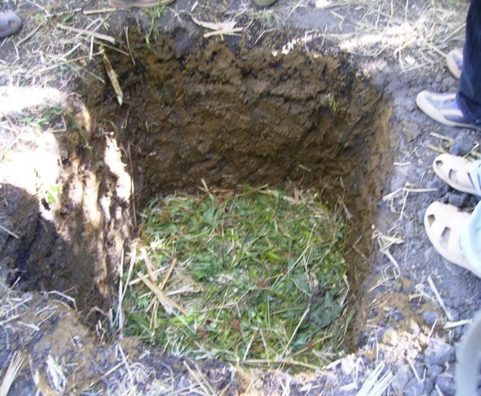
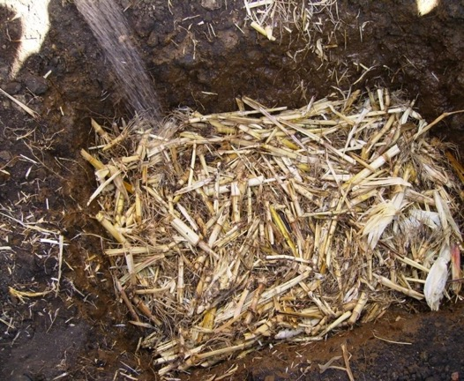
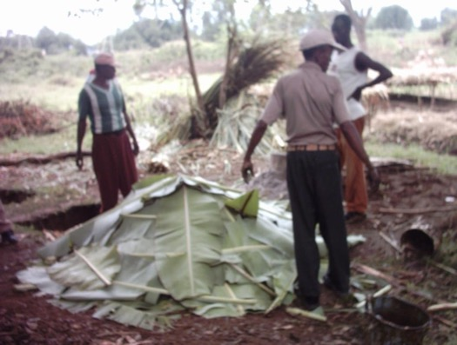
Composting of bioslurry: pit method

Slide 33
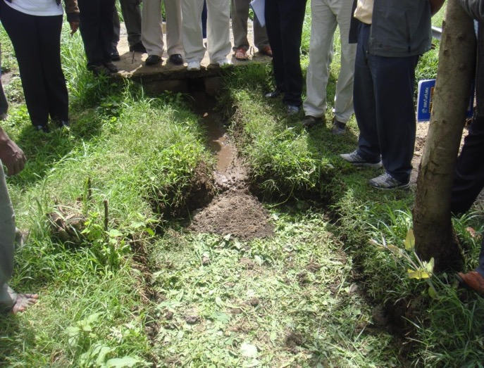
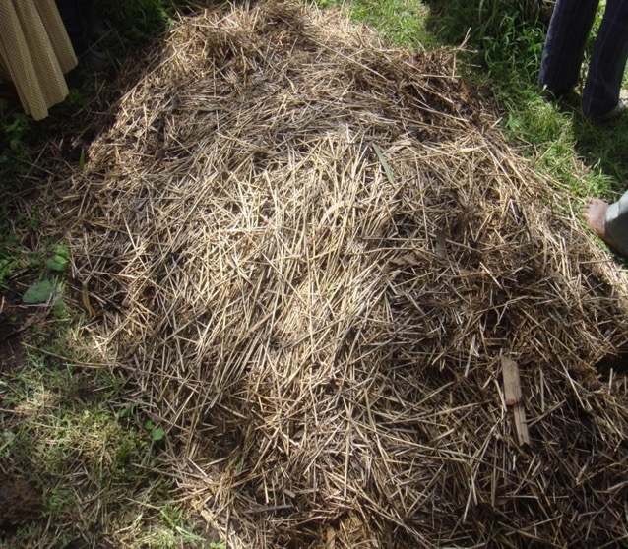
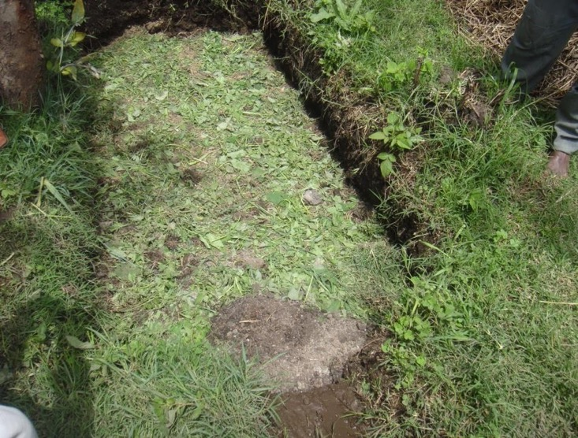

Slide 34
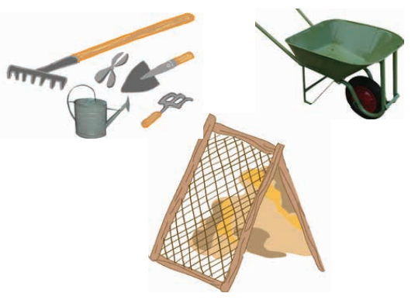
Summary: Practical aspects of composting
Check availability of recommended tools:
  pitchfork, shovel/spade
  watering can
  wheelbarrow
  sharp, pointed stick 2–3 m long (thermometer):
  to check heat development and water requirements
Climatic conditions of the area
Availability of organic materials
Area for the compost piles/pits

