Slide 1
Improving manure management
Module 5.
Manure use and application

Slide 2
Learning objectives of Module 5
Describe the main considerations for manure use
Present the value of manure and its direct benefits on soil fertility and crop productivity
Present manure application methods and the use of different types of manure

Slide 3
Main considerations

Slide 4
Manure use and/or application (1)
Main question: For what purpose will the farmer use the manure?
    Recycling nutrients on farm? : to fertilize crops (which crops?) and improve soil fertility
    Feeding the biodigester?
    Selling or giving away for free to customers with special demands? For example: dried solids to fellow farmers who grow vegetables or flowers
    Selling to the urban market? : compost to garden shops?

Slide 5
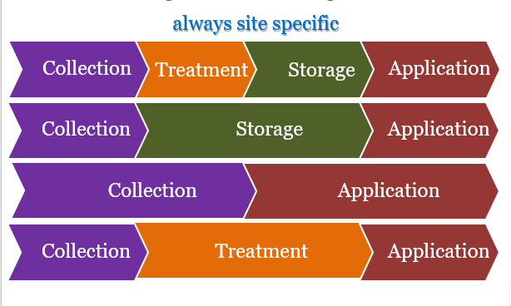
Manure use and/or application (2)
Collection, storage, treatment will determine final composition of the manure or end product
Laboratory analysis of the composition of the manure or end product will indicate its quality and value

Slide 6
Recycling the nutrients: main factors to consider
  The value of manure available (slurry, farmyard manure, solids, liquids, compost)
  Stocking rate (determines quantity of manure available)
  Land area available and crops grown – fertilizer recommendations (determines how much and when manure can be applied)
  The import and export of nutrients on the farm (with a high stocking rate and large import of feeds, there could be a surplus of nutrients)
  The soil fertility status:
    if no or little import of nutrients: the soil fertility status will decline
    soil sampling and analysis should be done to determine deficiencies

Slide 7
Value and benefits of manure

Slide 8
Value of manure compared to mineral fertilizer
Advantages of manure/manure products compared to mineral fertilizer:
  More nutrients are (recycled) and manure provides micro-mineral;
  Some nutrients like P are better available (especially on acid soils)
  Addition of organic matter improves soil fertility status, soil structure and water-holding capacity
Disadvantages of manure/manure products compared to mineral fertilizer:
  Short-term effect on crop growth often low due to low mineral N content (e.g. composted manure)
  Right dosing of nutrients (N,P, K, etc.) according to crop needs is more difficult with manure

Slide 9
Direct effect of manure on crop growth and soil fertility
The direct/short-term effect of manure on crop growth depends on:
    mineral deficiencies in the soil: soil testing is recommended
    the mineral N content in the manure/manure product:
      fresh cattle slurry or fresh bioslurry: relatively high content
      composted cattle dung: low content
    application method:
      surface application of fresh cattle slurry or bioslurry versus incorporation or mixing with soil: effect on loss of N (ammonia)
      use of trenches to let slurry flow: high losses of N (ammonia) and run-off/leaching of other minerals

Slide 10
Example: Recycling nutrients to forage crops
A system of recycling fresh slurry or liquids to Napier grass or other forage crop in a zero-grazing system could look like:
Collection and storage: slurry is collected in a roofed zero-grazing unit with a concrete floor and stored for less than a week in a concrete lined pit with a cover
Application:
  Napier grass is cut daily to feed the cows and slurry/ liquids are taken and applied in small dug ditches between the plant rows where grass was cut and the ditches are covered again with soil
  Slurry can be put on the soil that is dug and weeded immediately so that slurry/liquids are mixed with soil

Slide 11
Effect of application method of fresh cattle slurry
  Effect of application of cattle slurry (derived from zero-grazing unit, short storage) in Naivasha, Kenya showed:
  Superficial application (spreading of manure in between plant rows)
    The N in slurry is only 25% as effective as N from mineral fertilizer
  Incorporate the slurry directly into the soil (during weeding) or make small ditches in between plant rows and cover with soil:
    The N in slurry is 50% as effective as N from mineral fertilizer
    Fresh cattle slurry mixed with soil between the rows is not toxic for plants
    Disadvantage: labour intensive (preparing small ditches and covering with soil)

Slide 12
Use of liquids and solids in system of separate collection
  Liquids
  Apply regularly as top dressing of forage crops after cutting and/or on banana
  Application of liquids diluted with water reduces ammonia volatilization
  Solids
  Make into compost or dry
  Apply as basic fertilizer on land for growing vegetables, maize or banana
  Incorporate solids into the soil to reduce losses and to improve availability of nutrients

Slide 13
Exercise 1
The N content in slurry (mix of dung and urine) is 0.25%.
How much N from urea fertilizer is equal to the N in 20 tons slurry when the slurry is applied between the rows of Napier grass?
How much N from urea fertilizer is equal to the N in 10 tons of slurry when the slurry is applied in small ditches between the rows of Napier grass and covered with soil?

Slide 14
Exercise 1 answer
20 tons of cattle slurry applied superficially:
  20 x 0.25% N = 20,000 x 0.25/100= 200 x 0.25 = 50 kg N
  N from slurry is 25% as effective as N from urea
  N from slurry = 50 kg N x 25/100 = 1,250/100 = 12.5 kg N from urea
10 tons of cattle slurry applied in small ditches and covered with soil:
  10 x 0.25% N = 10,000 x 0.25/100 = 200 x 0.25 = 25 kg N
  N from slurry is 50% as effective as N from urea
  N from slurry = 25 kg N x 50/100 = 1,250/100 = 12.5 kg N from urea

Slide 15
Manure applications methods

Slide 16
Use of (dried) solids and compost (1)
Dried solids and compost: little or no mineral N and little K but nutrients like organic N, P, other nutrients and organic matter
Dried solids and compost are suitable for crops and soils which need:
  a small amount of continuous N
  crops that require a lot of P and build up the fertility status (nutrient base) of the soil
Incorporation or mixing with the soil at time of digging or ploughing improves the availability
Dried solids and compost are very suitable for the ‘tumbukiza’ system: planting forage or bananas in a hole filled with a mixture of soil and manure

Slide 17
‘Tumbukiza’ system
Before planting: dig holes of 2 by 2 ft wide and 2 ft deep at required planting distance for forage crop or banana (size of the hole can be different)
Keep the top-soil ( 1 ft) and the sub-soil (1 ft) apart
Put the banana stem in the hole
Mix the top-soil with manure (dried manure and or compost)
Fill the hole with the mixture of topsoil and manure but not completely
In the case of Napier grass, put 5 to 6 canes in the soil. After they have germinated, manure can be added and eventually mixed with the remaining subsoil

Slide 18
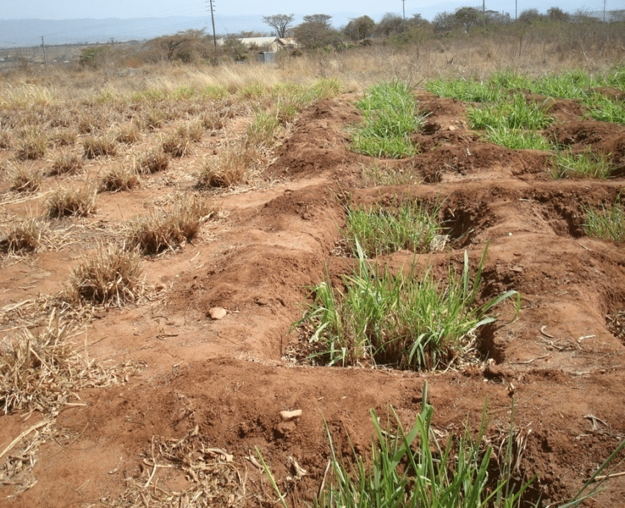
‘Tumbukiza system’
Farmers’ experiences with ‘tumbukiza system’ with Napier grass in Kenya:
Better growth (because concentration and gradual release of nutrients)
Better drought tolerance of the crop (high level of organic matter)
Risk: leaching of nutrients due to overfertilization
Disadvantage: labour intensive

