Slide 1
Module 6. Advising farmers on manure management
Improving manure management

Slide 2
Learning objectives of Module 6
Recommend proper manure management practices by assessing farm-specific needs:
Checklist of evaluating the current state of the farm and manure management practices
Checklist of economic aspects
Highlight considerations for decision-making about which manure management options to recommend to a farm

Slide 3
Recommend manure management practices

Slide 4
Purpose of advice and procedure
Based on evaluation of the farm and management and discussions with the farmer.
Propose improvements that are:
Feasible and economic to implement
Reduce nutrient losses and negative environmental effects
The discussion with the farmer
Transfer of information on improved manure management
Results of an evaluation of farm and management should support:
Customized advice is:
Purpose
Selection of feasible and economic improvement to apply by the farmer
To develop customized advice for a farmer on manure management

Slide 5
Purpose of advice and procedure
Purpose
Customized advice is:
Results of an evaluation of farm and management should support:
To develop customized advice for a farmer on manure management
Based on evaluation of the farm and management and discussions with the farmer.
Propose improvements that:
are feasible and economic to implement
reduce nutrient losses and negative environmental effects
the discussion with the farmer
transfer of information on improved manure management
selection of feasible and economic improvements to apply by the farmer

Slide 6

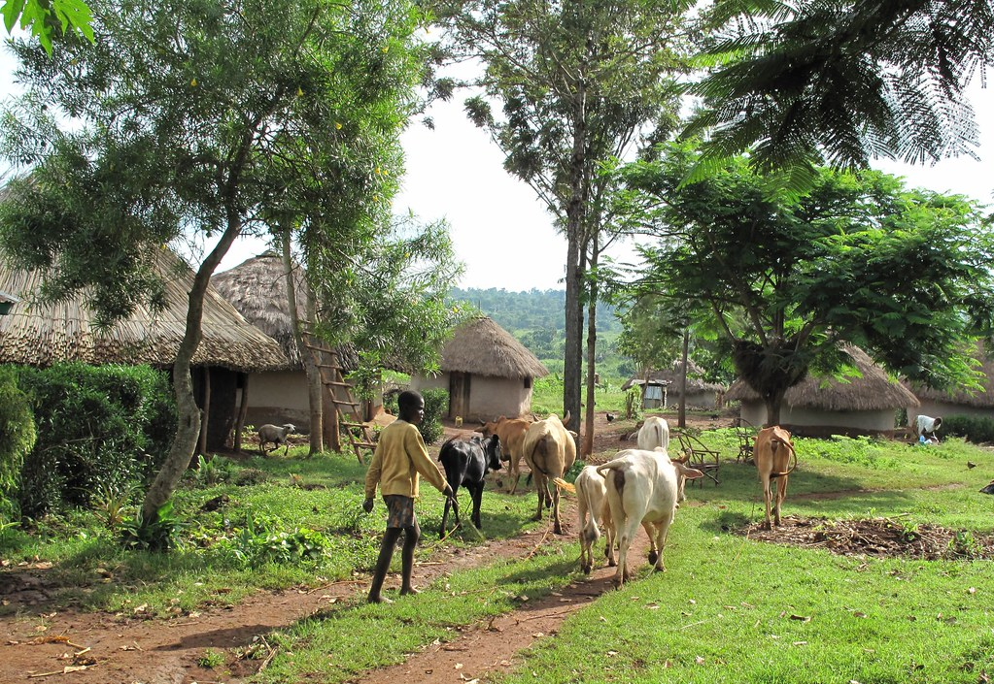

Checklist: Evaluation farm and manure management (1)
Farmer/farm:
Resources: poor/medium/rich
Full-time or part-time farmer
Location of the farm
Total farm size
Farming system/farm:
Landless (peri-urban)
Mixed crop-livestock
Specialised livestock system:
Low/medium/high input system
Land and land use
Soil fertility status: poor/medium/high
Area forage crops
Area food crops (specify)
Cash crops

Slide 7
Checklist of evaluation farm and manure management (2)
Livestock/dairy cattle:
System of dairy cow management: free range, cows tethered, zero-grazing, semi zero-grazing
Housing of dairy cattle:
Fodder, concentrates, minerals,
Synthetic fertilizer, manure
Inputs feeds/fertilizer:
Number of cows, young stock and other animals
Average milk production per cow
Zero-grazing unit with or without concrete floor
Shed with earthen floor
‘Boma’ : open, shed

Slide 8
Checklist evaluation of manure management (3)
Collection
No collection: discharge to water stream, public areas
Separate collection of dung and urine
Collection in a pit, pile
Only dung collected and piled
Storage
Type of storage: pit, heap/pile, sacks
Use of cover when stored
Treatment
Drying (dung, slurry)
Biodigestion
Composting
Use/application of manure
Application: on which crops, amounts, method of application
Sales: clients
Availability of vegetative/organic materials
Composting

Slide 9
Checklist evaluation economic farm situation (4)
Investments of farmer on manure management
Sources of income of the farmer:
milk
crop produce
other income
Labour availability:
family labour
paid labour

Slide 10
Considerations for decision-making

Slide 11
Some considerations when selecting options
Resources of the farmer: A resource-poor farmer has few opportunities to invest. Cheap, simple improvements are needed such as better collection and use of simple covers
Labour availability: Some options like composting require extra labour
Stocking rate: If high, e.g. 5 cows per ha land available, manure load is most likely too much and manure has to be sold or made into a saleable product like compost
Availability of (dry/green) vegetative materials which could be used for making compost
Market for surplus manure and/or compost

Slide 12
Steps to advise on improved manure management
Make an inventory of options to improve manure management
Discuss and select options with the farmer
Prioritize options and agree with the farmer which options to implement
Prepare together with the farmer a plan and time schedule for implementation
Follow up on the implementation and collect farmer’s opinions
Collection: improvements on the housing system
Storage: improvements on the storage: manure pit, covers
Treatment: drying? composting?
Use and application of manure: fertilization plan for the crop, method of application

