Slide 1
Context – why Youth employment and Entrepreneurship
The global youth unemployment rate estimated at 13.1 per cent, with young people more likely to be unemployed, underemployed, or working in poverty, particularly in Africa and Asia.
There are additional barriers to employment for young women, young people in rural areas, persons with disabilities, young people living in fragile contexts, and socially excluded groups.
While youth un- and under- employment can partly be attributed to limited work experience, there are also major structural barriers preventing young people from entering the labour market.
Economic empowerment and providing employment opportunities to young people –particularly in fragile contexts and for disadvantaged groups- can contribute to solving the multiple challenges of youth unemployment, poverty, and cross-cutting challenges like climate mitigation and adaptation, radicalization, and good governance.

Slide 2
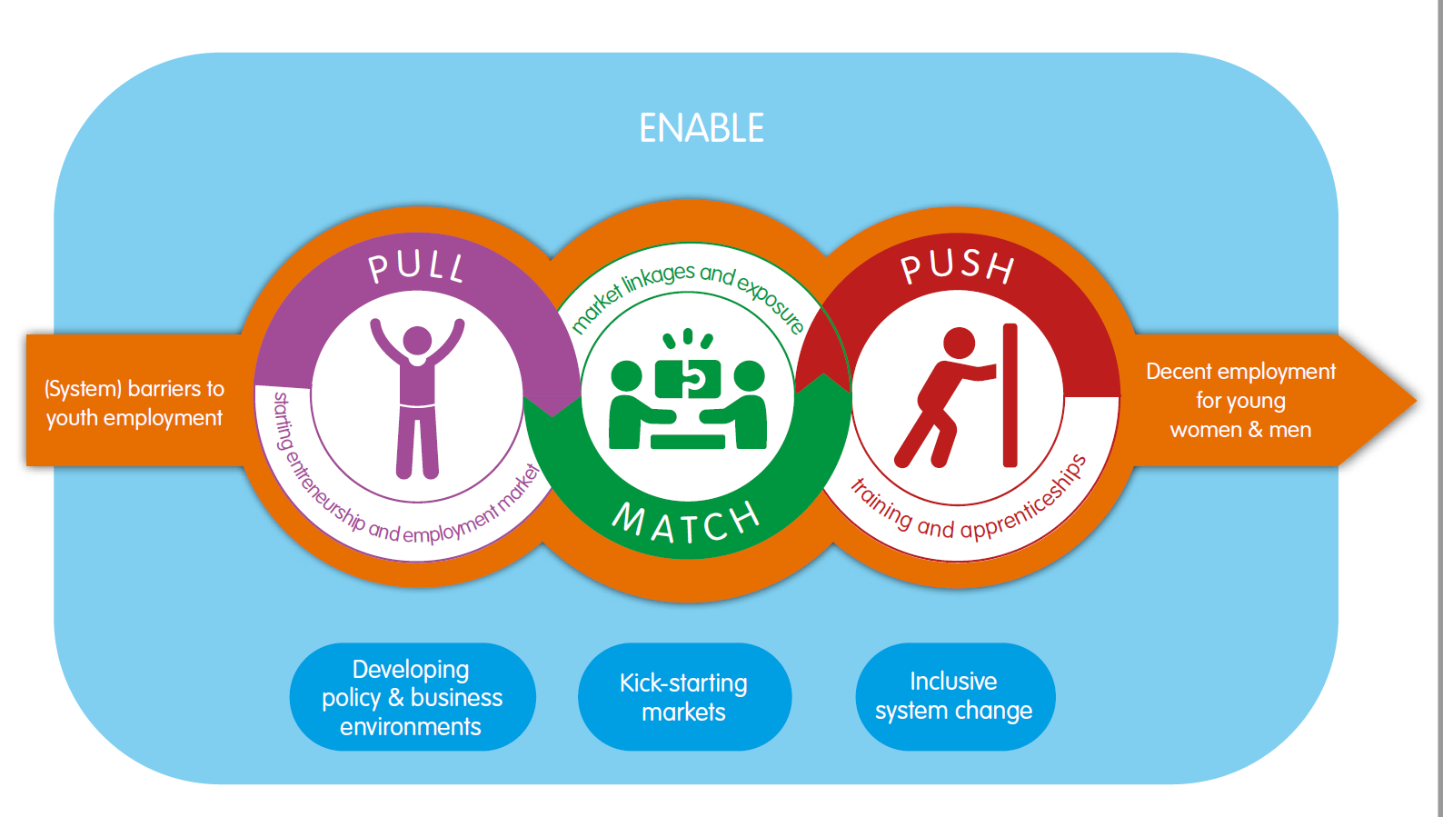
SNVs Approach / Strategy to YEE – PMPE
a) Improved livelihoods;
b) enterprise development & employment,
c) resilience and youth voice
d) Impact group: Unemployed and underemployed youth – 18-30/35.
Proof of concept & high scalability potential (implemented in more than 10 countries)
Partnerships with eco-system actors to support young people gain sustainable employment or business opportunities /contribute to a conducive / enabling environment and systems transformation
Non-linear yet context specific – policy env, private sector environment, youth dynamics etc.
An integrated market systems development approach: skills, markets, financial access, eco-system dev etc.
Cross-Sector – agri-food, energy and water sectors

Slide 3
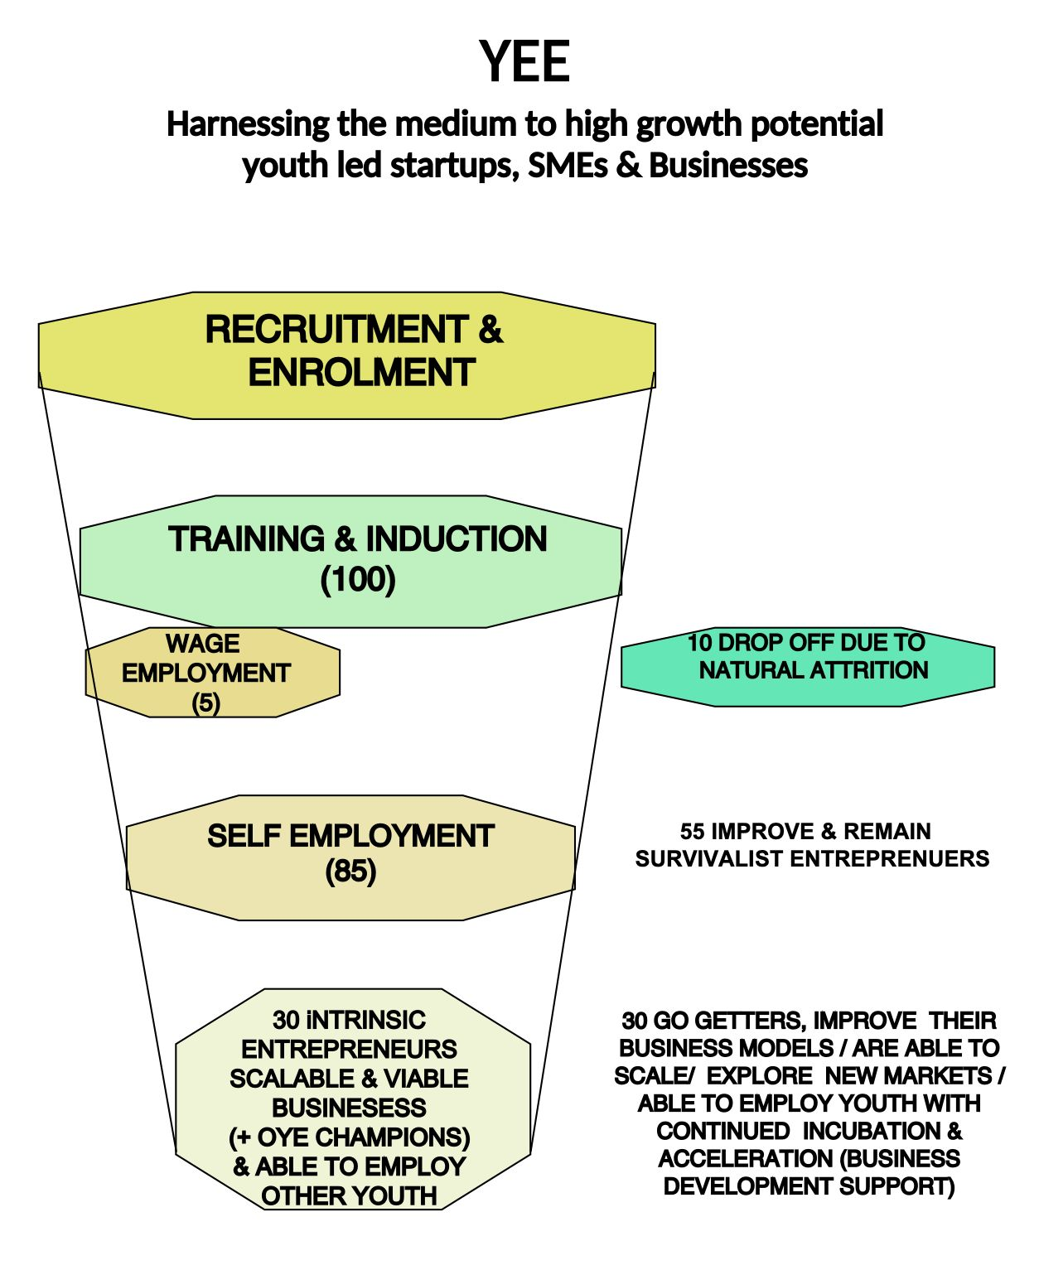
Strategy adaptation: A blended approach to YEE – context specific
a) Youth livelihood - supports equitable access to opportunities.
b) Youth-led enterprises - to contribute to food systems transformation and next generation of PS players – BDS – incubation and acceleration; institutionalised access to finance and markets diversification, etc.
Toc / market scan tools etc – Global >> contextualised.

